Slide 1
Introduction to Python

Slide 2
Overview
History
Names & Assignment
Sequences types: Lists, Tuples, and Strings
Mutability

Slide 3
Brief History of Python
Invented in the Netherlands, early 90s by Guido van Rossum
Named after Monty Python
Open sourced from the beginning
Considered a scripting language, but is much more
Scalable, object oriented and functional from the beginning
Used by Google from the beginning
Increasingly popular

Slide 4
The Python Interpreter
Typical Python implementations offer both an interpreter and compiler
Interactive interface to Python with a read-eval-print loop
[finin@linux2 ~]$ python
Python 2.4.3 (#1, Jan 14 2008, 18:32:40)
[GCC 4.1.2 20070626 (Red Hat 4.1.2-14)] on linux2
Type "help", "copyright", "credits" or "license" for more information.
>>> def square(x):
... return x * x
...
>>> map(square, [1, 2, 3, 4])
[1, 4, 9, 16]
>>>

Slide 5
The Basics

Slide 6
A Code Sample (in IDLE)
x = 34 - 23 # A comment.
y = “Hello” # Another one.
z = 3.45
if z == 3.45 or y == “Hello”:
x = x + 1
y = y + “ World” # String concat.
print x
print y

Slide 7
Enough to Understand the Code
Indentation matters to code meaning
Block structure indicated by indentation
First assignment to a variable creates it
Variable types don’t need to be declared.
Python figures out the variable types on its own.
Assignment is = and comparison is ==
For numbers + - * / % are as expected
Special use of + for string concatenation and % for string formatting (as in C’s printf)
Logical operators are words (and, or, not) not symbols
The basic printing command is print

Slide 8
Basic Datatypes
Integers (default for numbers)
z = 5 / 2 # Answer 2, integer division
Floats
x = 3.456
Strings
Can use “” or ‘’ to specify with “abc” == ‘abc’
Unmatched can occur within the string: “matt’s”
Use triple double-quotes for multi-line strings or strings than contain both ‘ and “ inside of them: “““a‘b“c”””

Slide 9
Whitespace
Whitespace is meaningful in Python: especially indentation and placement of newlines
Use a newline to end a line of code
Use \ when must go to next line prematurely
No braces {} to mark blocks of code, use consistent indentation instead
First line with less indentation is outside of the block
First line with more indentation starts a nested block
Colons start of a new block in many constructs, e.g. function definitions, then clauses

Slide 10
Comments
Start comments with #, rest of line is ignored
Can include a “documentation string” as the first line of a new function or class you define
Development environments, debugger, and other tools use it: it’s good style to include one
def fact(n):
“““fact(n) assumes n is a positive integer and returns facorial of n.””” assert(n>0)
return 1 if n==1 else n*fact(n-1)

Slide 11
Assignment
Binding a variable in Python means setting a name to hold a reference to some object
Assignment creates references, not copies
Names in Python do not have an intrinsic type, objects have types
Python determines the type of the reference automatically based on what data is assigned to it
You create a name the first time it appears on the left side of an assignment expression: x = 3
A reference is deleted via garbage collection after any names bound to it have passed out of scope
Python uses reference semantics (more later)

Slide 12
Naming Rules
Names are case sensitive and cannot start with a number. They can contain letters, numbers, and underscores.
bob Bob _bob _2_bob_ bob_2 BoB
There are some reserved words:
and, assert, break, class, continue, def, del, elif, else, except, exec, finally, for, from, global, if, import, in, is, lambda, not, or, pass, print, raise, return, try, while

Slide 13
Naming conventions
The Python community has these recommend-ed naming conventions
joined_lower for functions, methods and, attributes
joined_lower or ALL_CAPS for constants
StudlyCaps for classes
camelCase only to conform to pre-existing conventions
Attributes: interface, _internal, __private

Slide 14
Assignment
You can assign to multiple names at the same time
>>> x, y = 2, 3
>>> x
2
>>> y
3
This makes it easy to swap values
>>> x, y = y, x
Assignments can be chained
>>> a = b = x = 2

Slide 15
Accessing Non-Existent Name
Accessing a name before it’s been properly created (by placing it on the left side of an assignment), raises an error
>>> y
Traceback (most recent call last):
File "<pyshell#16>", line 1, in -toplevel-
y
NameError: name ‘y' is not defined
>>> y = 3
>>> y
3

Slide 16
Sequence types: Tuples, Lists, and Strings

Slide 17
Sequence Types
Tuple: (‘john’, 32, [CMSC])
A simple immutable ordered sequence of items
Items can be of mixed types, including collection types
Strings: “John Smith”
Immutable
Conceptually very much like a tuple
List: [1, 2, ‘john’, (‘up’, ‘down’)]
Mutable ordered sequence of items of mixed types

Slide 18
Similar Syntax
All three sequence types (tuples, strings, and lists) share much of the same syntax and functionality.
Key difference:
Tuples and strings are immutable
Lists are mutable
The operations shown in this section can be applied to all sequence types
most examples will just show the operation performed on one

Slide 19
Sequence Types 1
Define tuples using parentheses and commas
>>> tu = (23, ‘abc’, 4.56, (2,3), ‘def’)
Define lists are using square brackets and commas
>>> li = [“abc”, 34, 4.34, 23]
Define strings using quotes (“, ‘, or “““).
>>> st = “Hello World”
>>> st = ‘Hello World’
>>> st = “““This is a multi-line
string that uses triple quotes.”””

Slide 20
Sequence Types 2
Access individual members of a tuple, list, or string using square bracket “array” notation
Note that all are 0 based…
>>> tu = (23, ‘abc’, 4.56, (2,3), ‘def’)
>>> tu[1] # Second item in the tuple.
‘abc’
>>> li = [“abc”, 34, 4.34, 23]
>>> li[1] # Second item in the list.
34
>>> st = “Hello World”
>>> st[1] # Second character in string.
‘e’

Slide 21
Positive and negative indices
>>> t = (23, ‘abc’, 4.56, (2,3), ‘def’)
Positive index: count from the left, starting with 0
>>> t[1]
‘abc’
Negative index: count from right, starting with –1
>>> t[-3]
4.56

Slide 22
Slicing: return copy of a subset
>>> t = (23, ‘abc’, 4.56, (2,3), ‘def’)
Return a copy of the container with a subset of the original members. Start copying at the first index, and stop copying before second.
>>> t[1:4]
(‘abc’, 4.56, (2,3))
Negative indices count from end
>>> t[1:-1]
(‘abc’, 4.56, (2,3))

Slide 23
Slicing: return copy of a =subset
>>> t = (23, ‘abc’, 4.56, (2,3), ‘def’)
Omit first index to make copy starting from beginning of the container
>>> t[:2]
(23, ‘abc’)
Omit second index to make copy starting at first index and going to end
>>> t[2:]
(4.56, (2,3), ‘def’)

Slide 24
Copying the Whole Sequence
[ : ] makes a copy of an entire sequence
>>> t[:]
(23, ‘abc’, 4.56, (2,3), ‘def’)
Note the difference between these two lines for mutable sequences
>>> l2 = l1 # Both refer to 1 ref,
# changing one affects both
>>> l2 = l1[:] # Independent copies, two refs

Slide 25
The ‘in’ Operator
Boolean test whether a value is inside a container:
>>> t = [1, 2, 4, 5]
>>> 3 in t
False
>>> 4 in t
True
>>> 4 not in t
False
For strings, tests for substrings
>>> a = 'abcde'
>>> 'c' in a
True
>>> 'cd' in a
True
>>> 'ac' in a
False
Be careful: the in keyword is also used in the syntax of for loops and list comprehensions

Slide 26
The + Operator
The + operator produces a new tuple, list, or string whose value is the concatenation of its arguments.
>>> (1, 2, 3) + (4, 5, 6)
(1, 2, 3, 4, 5, 6)
>>> [1, 2, 3] + [4, 5, 6]
[1, 2, 3, 4, 5, 6]
>>> “Hello” + “ ” + “World”
‘Hello World’

Slide 27
The * Operator
The * operator produces a new tuple, list, or string that “repeats” the original content.
>>> (1, 2, 3) * 3
(1, 2, 3, 1, 2, 3, 1, 2, 3)
>>> [1, 2, 3] * 3
[1, 2, 3, 1, 2, 3, 1, 2, 3]
>>> “Hello” * 3
‘HelloHelloHello’

Slide 28
Mutability: Tuples vs. Lists

Slide 29
Lists are mutable
>>> li = [‘abc’, 23, 4.34, 23]
>>> li[1] = 45
>>> li [‘abc’, 45, 4.34, 23]
We can change lists in place.
Name li still points to the same memory reference when we’re done.

Slide 30
Tuples are immutable
>>> t = (23, ‘abc’, 4.56, (2,3), ‘def’)
>>> t[2] = 3.14
Traceback (most recent call last):
File "<pyshell#75>", line 1, in -toplevel-
tu[2] = 3.14
TypeError: object doesn't support item assignment
You can’t change a tuple.
You can make a fresh tuple and assign its reference to a previously used name.
>>> t = (23, ‘abc’, 3.14, (2,3), ‘def’)
The immutability of tuples means they’re faster than lists.

Slide 31
Operations on Lists Only
>>> li = [1, 11, 3, 4, 5]
>>> li.append(‘a’) # Note the method syntax
>>> li
[1, 11, 3, 4, 5, ‘a’]
>>> li.insert(2, ‘i’)
>>>li
[1, 11, ‘i’, 3, 4, 5, ‘a’]

Slide 32
The extend method vs +
+ creates a fresh list with a new memory ref
extend operates on list li in place.
>>> li.extend([9, 8, 7])
>>> li
[1, 2, ‘i’, 3, 4, 5, ‘a’, 9, 8, 7]
Potentially confusing:
extend takes a list as an argument.
append takes a singleton as an argument.
>>> li.append([10, 11, 12])
>>> li
[1, 2, ‘i’, 3, 4, 5, ‘a’, 9, 8, 7, [10, 11, 12]]

Slide 33
Operations on Lists Only
Lists have many methods, including index, count, remove, reverse, sort
>>> li = [‘a’, ‘b’, ‘c’, ‘b’]
>>> li.index(‘b’) # index of 1st occurrence
1
>>> li.count(‘b’) # number of occurrences
2
>>> li.remove(‘b’) # remove 1st occurrence
>>> li
[‘a’, ‘c’, ‘b’]

Slide 34
Operations on Lists Only
>>> li = [5, 2, 6, 8]
>>> li.reverse() # reverse the list *in place*
>>> li
[8, 6, 2, 5]
>>> li.sort() # sort the list *in place*
>>> li
[2, 5, 6, 8]
>>> li.sort(some_function)
# sort in place using user-defined comparison

Slide 35
Tuple details
The comma is the tuple creation operator, not parens
>>> 1,
(1,)
Python shows parens for clarity (best practice)
>>> (1,)
(1,)
Don't forget the comma!
>>> (1)
1
Trailing comma only required for singletons others
Empty tuples have a special syntactic form
>>> ()
()
>>> tuple()
()

Slide 36
Summary: Tuples vs. Lists
Lists slower but more powerful than tuples
Lists can be modified, and they have lots of handy operations and mehtods
Tuples are immutable and have fewer features
To convert between tuples and lists use the list() and tuple() functions:
li = list(tu)
tu = tuple(li)

Slide 37
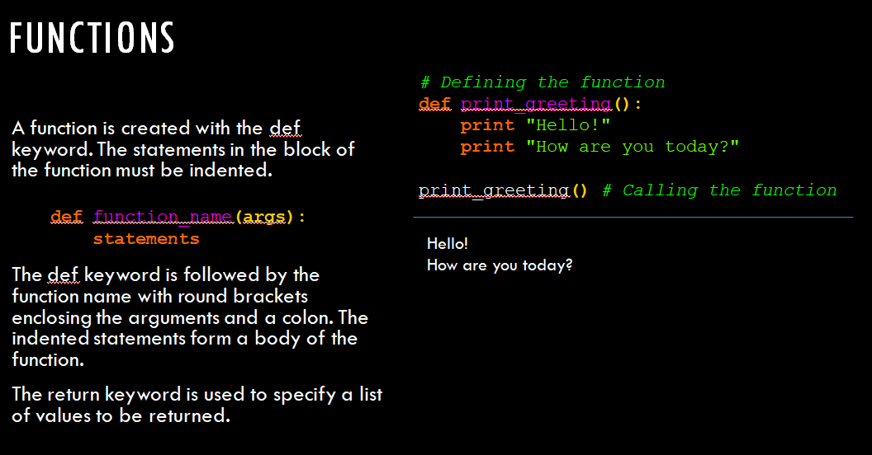

Slide 38
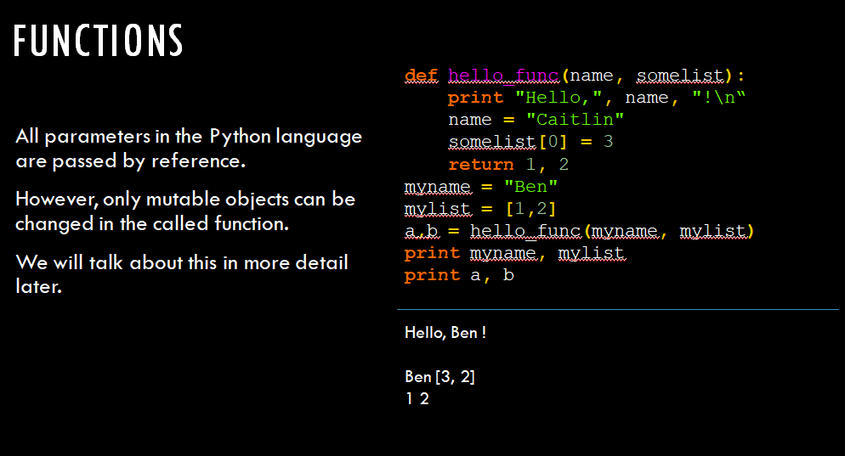

Slide 39
